Slide 1



CST 347 – Real Time OS
Lecture 14 – Synchronization III / Deadlocks
Troy Scevers

Slide 2
Topics
Introduce Deadlocks and Priority Inversion
Classic Problems of Synchronization
  Bounded-Buffer
  Readers-Writers
  Dining-Philosophers

Slide 3
Introduction to Deadlocks and Starvation
Deadlock – two or more processes are waiting indefinitely for an event that can be caused by only one of the waiting processes
Starvation – indefinite blocking
  A process may never be removed from the semaphore queue in which it is suspended
Let S and Q be two semaphores initialized to 1
P₀ P₁
wait(S); wait(Q);
wait(Q); wait(S);
. .
signal(S); signal(Q);
signal(Q); signal(S);
Notes:
P0 Executes wait(s), then P1 executes wait(Q)
When P0 executes wait(Q), it must wait until P1 executes Signal(Q). When P1 executes wait(S), it must wait until P0 executes signal(S). Since these signal() operations cannot be executed, P0 and P1 are deadlocked.
Starvation:
Example, low-priority thread waiting for resources constantly in use by high-priority threads
Deadlock vs. Starvation
Starvation can end (but doesn’t have to)
Deadlock can’t end without external intervention

Slide 4
Introduction to Deadlocks and Starvation
Deadlock – two or more processes are waiting indefinitely for an event that can be caused by only one of the waiting processes
Starvation – indefinite blocking
  A process may never be removed from the semaphore queue in which it is suspended
Let S and Q be two semaphores initialized to 1
Continue
Continue
P₀
P₁
wait(S)
wait(S)
wait(Q)
wait(Q)
Resource 1
S
Resource 2
Q
Notes:
P0 Executes wait(s), then P1 executes wait(Q)
When P0 executes wait(Q), it must wait until P1 executes Signal(Q). When P1 executes wait(S), it must wait until P0 executes signal(S). Since these signal() operations cannot be executed, P0 and P1 are deadlocked.
Starvation:
Example, low-priority thread waiting for resources constantly in use by high-priority threads
Deadlock vs. Starvation
Starvation can end (but doesn’t have to)
Deadlock can’t end without external intervention

Slide 5
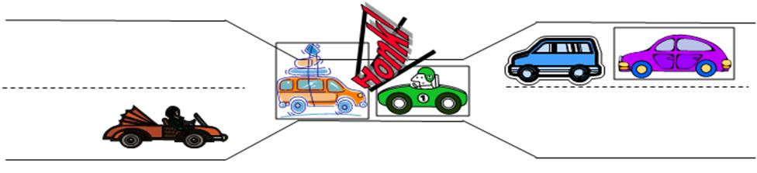
Deadlock
Notes:
Consider the bridge crossing example:
Each segment of road can be viewed as a resource
Car must own the segment under them
Must acquire segment that they are moving into
For bridge:
must acquire both halves
Traffic only in one direction at a time
Problem occurs when two cars in opposite directions on bridge: each acquires one segment and needs next
If a deadlock occurs, it can be resolved if one car backs up (preempt resources and rollback)
Several cars may have to be backed up
Starvation is possible
East-going traffic really fast
no one goes west

Slide 6
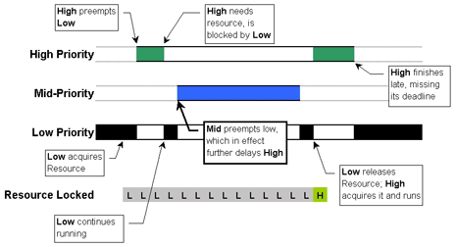
Priority Inversion
Scheduling problem when a lower-priority process holds a lock needed by a higher priority process

Slide 7

Mars Pathfinder
High priority task for doing data-bus was being held off by a low priority task for meterological data
Every so often, this low priority task would be preempted by the communications task
This resulted in a watchdog timeout for the databus task and a total system reset
Full Description of problem available at:
http://research.microsoft.com/en-us/um/people/mbj/mars_pathfinder/mars_pathfinder.html
Notes:
Used VxWorks
They were able to fix the problem with priority inheritance.
They left debug enabled so were able to patch the system live on mars.

Slide 8
Solving Priority Inversion
Best method is to design system so that priority inversion cannot happen
Two Protocols to deal with it
  Priority Ceiling Protocol
  Priority Inheritance Protocol
Notes:
One way to solve priority inversion is to use the priority ceiling protocol, which gives each shared resource a predefined priority ceiling. When a task acquires a shared resource, the task is hoisted (has its priority temporarily raised) to the priority ceiling of that resource. The priority ceiling must be higher than the highest priority of all tasks that can access the resource, thereby ensuring that a task owning a shared resource won't be preempted by any other task attempting to access the same resource. When the hoisted task releases the resource, the task is returned to its original priority level. Any operating system that allows task priorities to change dynamically can be used to implement the priority ceiling protocol.
On the downside, the priority ceiling protocol has poor average-case response time because of the significant overhead associated with implementing the protocol. Every time a shared resource is acquired, the acquiring task must be hoisted to the resource's priority ceiling. Conversely, every time a shared resource is released, the hoisted task's priority must be lowered to its original level. All this extra code takes time.

Slide 9
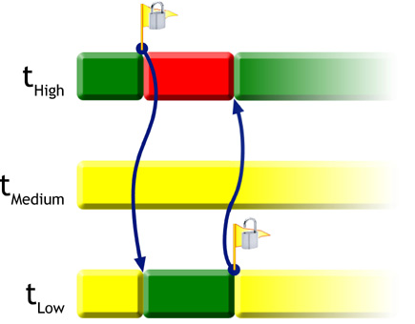
Priority Inheritance
Low priority acquires resource it stays at its priority
If Higher leverl priority task requests the resource, the lower priority task is raised to the priority level of the higher priority task
Once finished processing the lower priority task resumes its original priority
Notes:
FreeRTOS uses a MUTEX to implement priority inheritance protocol

Slide 10
Classic Problems of Synchronization
Introduce Deadlocks and Priority Inversion
Classic Problems of Synchronization
  Bounded-Buffer
  Readers-Writers
  Dining-Philosophers

Slide 11
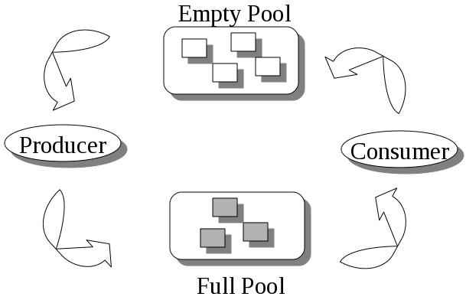
Bounded-Buffer Problem
Also called producer's-consumer's problem
When item is being added or removed the buffer is in inconsistent state
  Tasks must have exclusive access to the buffer
Consumer task must block on an empty buffer
Notes:
Producer must block on a full buffer

Slide 12
Original Solution
// Producer
while (true) {
/* produce an item in next produced */
while (counter == BUFFER SIZE); /* do nothing */
buffer[in] = next produced;
in = (in + 1) % BUFFER SIZE;
counter++;
}
// Consumer
while (true) {
while (counter == 0); /* do nothing */
next consumed = buffer[out];
out = (out + 1) % BUFFER SIZE;
counter--;
/* consume the item in next consumed */
}

Slide 13
One Solution
int itemCount = 0;
procedure producer() {
while (true) {
item = produceItem();
if (itemCount == BUFFER_SIZE) {
sleep();
}
putItemIntoBuffer(item);
itemCount = itemCount + 1;
if (itemCount == 1) {
wakeup(consumer);
}
}
}
procedure consumer() {
while (true) {
if (itemCount == 0) {
sleep();
}
item = removeItemFromBuffer();
itemCount = itemCount - 1;
if (itemCount == BUFFER_SIZE - 1) {
wakeup(producer);
}
consumeItem(item);
}
Notes:
What are the problems with this method???
The problem with this solution is that it contains a race condition that can lead to a deadlock. Consider the following scenario:
The consumer has just read the variable itemCount, noticed it's zero and is just about to move inside the if block.
Just before calling sleep, the consumer is interrupted and the producer is resumed.
The producer creates an item, puts it into the buffer, and increases itemCount.
Because the buffer was empty prior to the last addition, the producer tries to wake up the consumer.
Unfortunately the consumer wasn't yet sleeping, and the wakeup call is lost. When the consumer resumes, it goes to sleep and will never be awakened again. This is because the consumer is only awakened by the producer when itemCount is equal to 1.
The producer will loop until the buffer is full, after which it will also go to sleep.
Since both processes will sleep forever, we have run into a deadlock. This solution therefore is unsatisfactory.

Slide 14
Solution using semaphores
semaphore fillCount = 0; // items produced
semaphore emptyCount = BUFFER_SIZE; // remaining space
procedure producer() {
while (true) {
item = produceItem();
down(emptyCount);
putItemIntoBuffer(item);
up(fillCount);
}
}
procedure consumer()
{
while (true) {
down(fillCount);
item = removeItemFromBuffer();
up(emptyCount);
consumeItem(item);
}
}
Notes:
Semaphores solve the problem of lost wakeup calls.
The solution above works fine when there is only one producer and consumer. With multiple producers sharing the same memory space for the item buffer, or multiple consumers sharing the same memory space, this solution contains a serious race condition that could result in two or more processes reading or writing into the same slot at the same time. To understand how this is possible, imagine how the procedure putItemIntoBuffer() can be implemented. It could contain two actions, one determining the next available slot and the other writing into it. If the procedure can be executed concurrently by multiple producers, then the following scenario is possible:
Two producers decrement emptyCount
One of the producers determines the next empty slot in the buffer
Second producer determines the next empty slot and gets the same result as the first producer
Both producers write into the same slot

Slide 15
Bounded-Buffer continued
Lets assume the following shared data for our producer/consumer
  n buffer, each can hold one item
  Semaphore mutex initialized to 1
  Semaphore full initialized to 0
  Semaphore empty initialized to the value n
Notes:
To overcome this problem, we need a way to make sure that only one producer is executing putItemIntoBuffer() at a time. In other words we need a way to execute a critical section with mutual exclusion. To accomplish this we use a binary semaphore called mutex. Since the value of a binary semaphore can be only either one or zero, only one process can be executing between down(mutex) and up(mutex).

Slide 16
Bounded-Buffer continued
The structure of the producer task
do {
...
/* produce an item in next_produced */
...
wait(empty);
wait(mutex);
...
/* add next produced to the buffer */
...
signal(mutex);
signal(full);
} while (true);

Slide 17
Bounded-Buffer continued
The structure of the consumer task
do {
wait(full);
wait(mutex);
...
/* remove an item from buffer to next_consumed */
...
signal(mutex);
signal(empty);
...
/* consume the item in next consumed */
...
} while (true);

Slide 18
Readers-Writers Problem
Data Set is shared among a set of concurrent tasks
  Readers – only read the data set; they do not perform any updates
  Writers – can both read and write
Problem – allow multiple readers to read at the same time
  Only on single writer can access the shared data at one time
Several variations of how readers and writers are treated – all involve priorities

Slide 19
Readers-Writers Problem (cont)
First variation
  No reader is kept waiting unless the writer has permission to use the shared resource
  Also called the readers-preference
Notes:
Suppose we have a shared memory area with the constraints detailed above. It is possible to protect the shared data behind a mutual exclusion mutex, in which case no two threads can access the data at the same time. However, this solution is suboptimal, because it is possible that a reader R1 might have the lock, and then another reader R2 requests access. It would be foolish for R2 to wait until R1 was done before starting its own read operation; instead, R2 should start right away.

Slide 20
Readers-Writers Problem (cont)
semaphore wrt=1,mutex=1;
readcount=0;
writer()
{
wait(wrt);
//writing is done
signal(wrt);
}
reader()
{
wait(mutex);
readcount++;
if(readcount==1)
wait(wrt);
signal(mutex);
///Do the Reading
///(Critical Section Area)
wait(mutex);
readcount--;
if(readcount==0)
signal(wrt);
signal(mutex);
}
Notes:
What could be a problem with this solution???
Writer could starve...
Semaphores are initialized to 1
Note: if writer is in critical section. Then 1 reader is queued on wrt. And n-1 readers are queued on mutex

Slide 21
Readers-Writers Problem (cont)
Second Variation
  Once writer is ready, it performs write ASAP
  Also called writers-preference
Notes:
Suppose we have a shared memory area protected by a mutex, as above. This solution is suboptimal, because it is possible that a reader R1 might have the lock, a writer W be waiting for the lock, and then a reader R2 requests access. It would be foolish for R2 to jump in immediately, ahead of W; if that happened often enough, W would starve. Instead, W should start as soon as possible.

Slide 22
Readers-Writers Problem (cont)
int readcount, writecount; (initial value = 0)
semaphore mutex_1, mutex_2, mutex_3, w, r ; (initial value = 1)
READER
wait(mutex_3);
wait(r);
wait(mutex_1);
readcount := readcount + 1;
if readcount = 1 then wait(w);
signal(mutex_1);
signal(r);
signal(mutex_3);
reading is performed
wait(mutex_1);
readcount := readcount - 1;
if readcount = 0 then signal(w);
signal(mutex_1);
WRITER
wait(mutex_2);
writecount := writecount + 1;
if writecount = 1 then wait(r);
signal(mutex_2);
wait(w);
writing is performed
signal(w);
wait(mutex_2);
writecount := writecount - 1;
if writecount = 0 then signal(r);
signal(mutex_2);
Notes:
What Problems could this solution present???
Reader could starve.

Slide 23
Readers-Writers Problem (cont)
Both variations lead to starvation
Some systems solve this problem with a read-writer lock
  Reader-writer lock useful in
    Applications where it is easy to identify tasks that are readers and writers
    Applications with more readers than writers
Notes:
a synchronization primitive that solves one of the readers-writers problems. A readers-writer lock is like a mutex, in that it controls access to a shared resource, allowing concurrent access to multiple threads for reading but restricting access to a single thread for writes (or other changes) to the resource. A common use might be to control access to a data structure in memory that can't be updated atomically and isn't valid (and shouldn't be read by another thread) until the update is complete.
Therefore, the third readers-writers problem is sometimes proposed, which adds the constraint that no thread shall be allowed to starve; that is, the operation of obtaining a lock on the shared data will always terminate in a bounded amount of time.
Note also that this solution can only satisfy the condition that "no thread shall be allowed to starve" if and only if semaphores preserve first-in first-out ordering when blocking and releasing threads. Otherwise, a blocked writer, for example, may remain blocked indefinitely with a cycle of other writers decrementing the semaphore before it can.

Slide 24

Dining-Philosophers Problem
Philosophers spend life eating and thinking
Don't interact with neighbors, occasionally try to pick up 2 chopsticks (one at a time) to eat from bowl
  Need two to eat, then release them when done
Notes:
The problem is how to design a discipline of behavior (a concurrent algorithm) such that each philosopher won't starve; i.e., can forever continue to alternate between eating and thinking assuming that any philosopher cannot know when others may want to eat or think.
The problem was designed to illustrate the problem of avoiding deadlock, a system state in which no progress is possible. To see that designing a proper solution to this problem isn't obvious, consider the following proposal: instruct each philosopher to behave as follows:

Slide 25
Dining-Philosophers Problem
Try #1
  Take the left chopstick. If unavailable, block until it is available
  Take the right chopstick. If unavailable, block until it is available
  Eat
  Put down right chopstick
  Put down left chopstick
  Think
  Repeat
Notes:
Why does this fail????
This attempt at a solution fails: it allows the system to reach a deadlock state, in which no progress is possible.
This is the state in which each philosopher has picked up the fork to the left, waiting for the fork to the right to be put down. With the given instructions, this state can be reached, and when it is reached, the philosophers will eternally wait for each other to release a fork.[4]
Resource starvation might also occur independently of deadlock if a particular philosopher is unable to acquire both forks because of a timing problem. For example there might be a rule that the philosophers put down a fork after waiting ten minutes for the other fork to become available and wait a further ten minutes before making their next attempt. This scheme eliminates the possibility of deadlock (the system can always advance to a different state) but still suffers from the problem of livelock. If all five philosophers appear in the dining room at exactly the same time and each picks up the left fork at the same time the philosophers will wait ten minutes until they all put their forks down and then wait a further ten minutes before they all pick them up again.

Slide 26
Dining-Philosophers Problem
Try #2
  Take the left chopstick. If right chopstick is unavailable, put down the left chopstick and wait for a while. Try again.
  Take right chopstick.
  Eat
  Put down right chopstick
  Put down left chopstick
  Think
  Repeat
Notes:
Why does this fail???
Resource starvation might also occur independently of deadlock if a particular philosopher is unable to acquire both forks because of a timing problem. For example there might be a rule that the philosophers put down a fork after waiting ten minutes for the other fork to become available and wait a further ten minutes before making their next attempt. This scheme eliminates the possibility of deadlock (the system can always advance to a different state) but still suffers from the problem of livelock. If all five philosophers appear in the dining room at exactly the same time and each picks up the left fork at the same time the philosophers will wait ten minutes until they all put their forks down and then wait a further ten minutes before they all pick them up again.

Slide 27
Dining-Philosophers Problem
Try #2
  If each philosopher waited a random amount of time, the chances of the livelock would be reduced
This is what CSMA/CD does in the ethernet protocol. (Carrier Sense Multiple Access/Collision Detection)
Notes:
Other possible solution
Allow only four philosophers to be sitting at any 1 time
Allow a philosopher to pick up chopsticks only if both are available
Asymmetric Solution – odd numbered philosopher picks up left, even numbered picks up right chopstick
There are others...

